Slide 1
Descriptive Analytics
By Nungo Tshidzumba

Slide 2
Agenda
Use fully cleansed dataset memo provided
Frequent flyer behavior
Average add-on spend by inquiry type
Flight delays by airport
Lounge usage by frequent flyers
Top 10 flight routes by frequency
Monthly add-on spend trends

Slide 3
Upload and read cleansed data
This is from the _Delta Airlines Loyalty Customer Cleansed Data excel file
For this Descriptive Analysis, we will focus on the Frequent Flier Sheet
We will be using Python and Jupyter Notebook for this visualisation

Slide 4
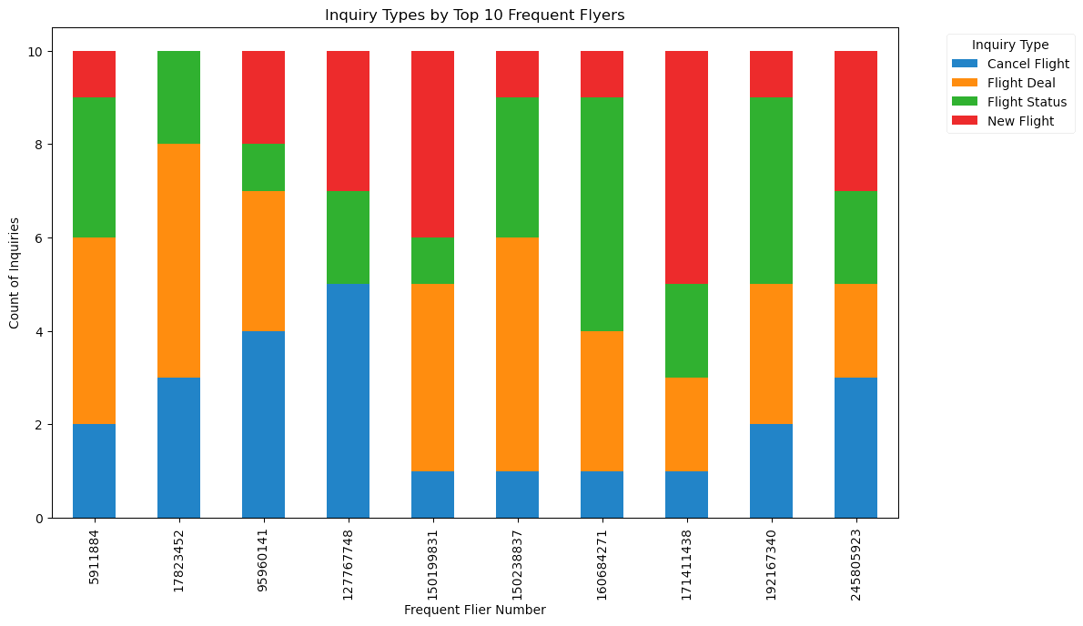
Frequent Flyer Behavior
This chart highlights the inquiry types made by the top 10 frequent flyers. By analyzing the volume of inquiries per frequent flyer, we gain insights into customer behavior patterns, identifying potential service opportunities and areas where frequent flyers may require additional attention or support.

Slide 5
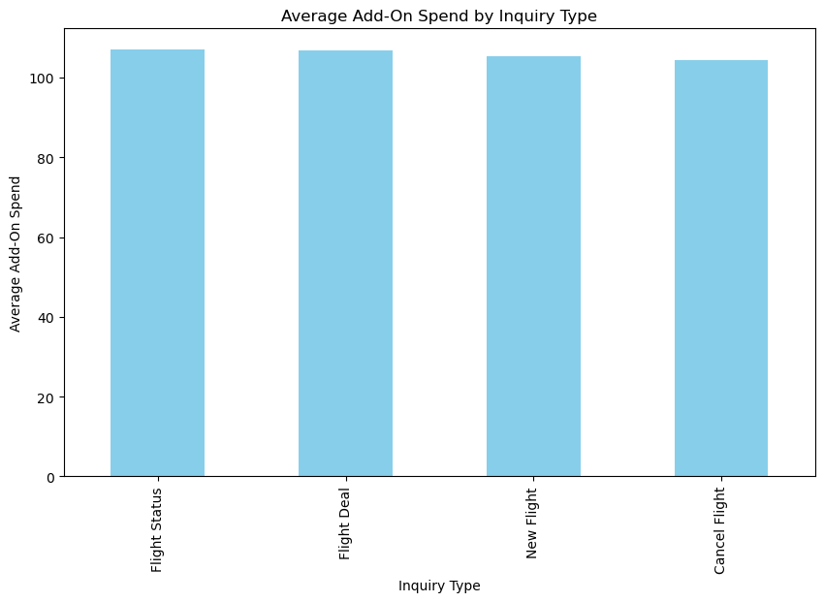
Average Add-On Spend by Inquiry Type
This bar chart displays the average add-on spend per inquiry type. By examining the relationship between customer inquiries and additional spending, this visualization uncovers which services or products are most likely to generate revenue, offering valuable insights into opportunities for targeted marketing or product development.

Slide 6
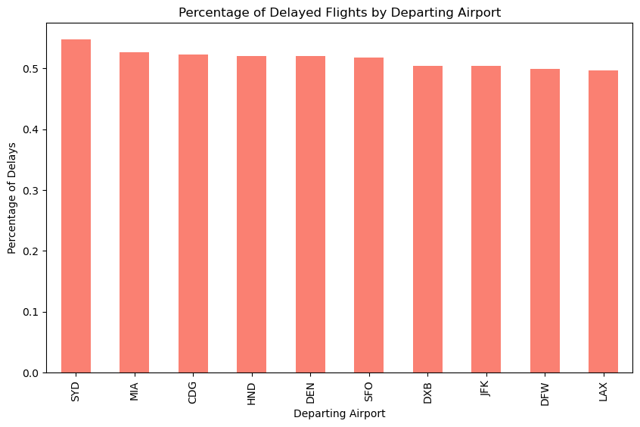
Flight Delays by Airport
This chart illustrates the top 10 airports with the highest average flight delays. By tracking delays by airport, Delta Airlines can identify operational inefficiencies and work to improve flight schedules, enhance customer satisfaction, and optimize their resource allocation at affected airports.

Slide 7
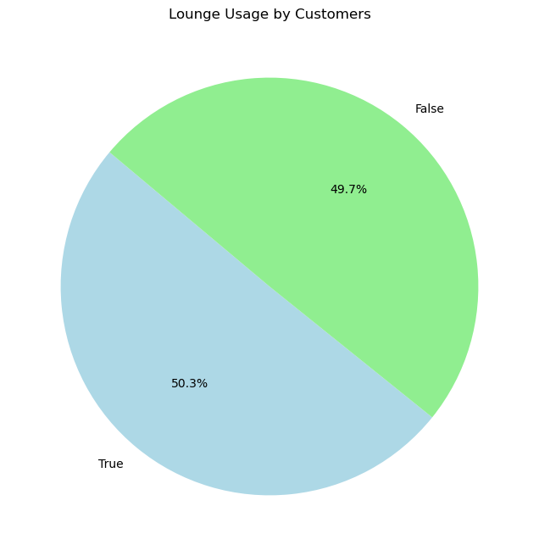
Lounge Usage by Frequent Flyers
This visualization shows the frequency of lounge visits by the most loyal customers (frequent flyers). Understanding which frequent flyers use the lounge most often can help Delta enhance the customer experience, tailor loyalty programs, and provide exclusive offers to high-value passengers, boosting retention.

Slide 8
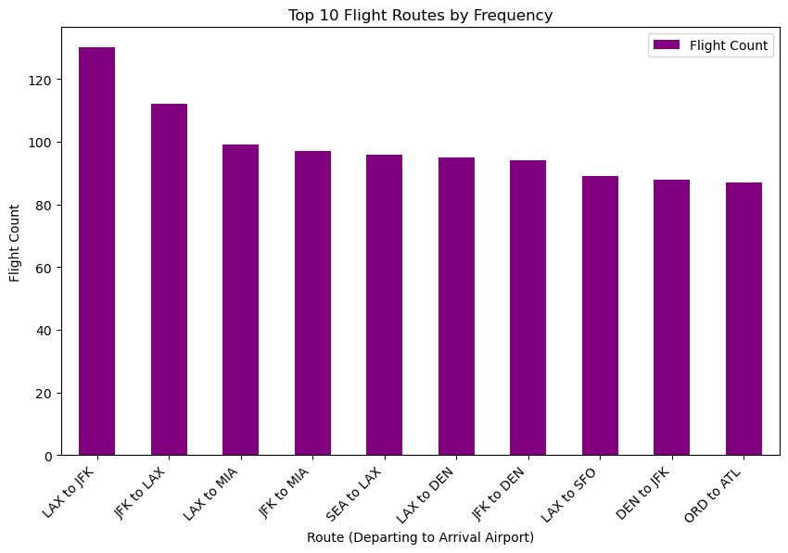
Top 10 Flight Routes by Frequency
This bar chart ranks the top 10 most popular flight routes based on flight count. It reveals Delta's busiest and most frequently traveled routes, which are crucial for resource planning, network optimization, and targeted marketing campaigns to increase customer engagement on high-traffic routes.

Slide 9
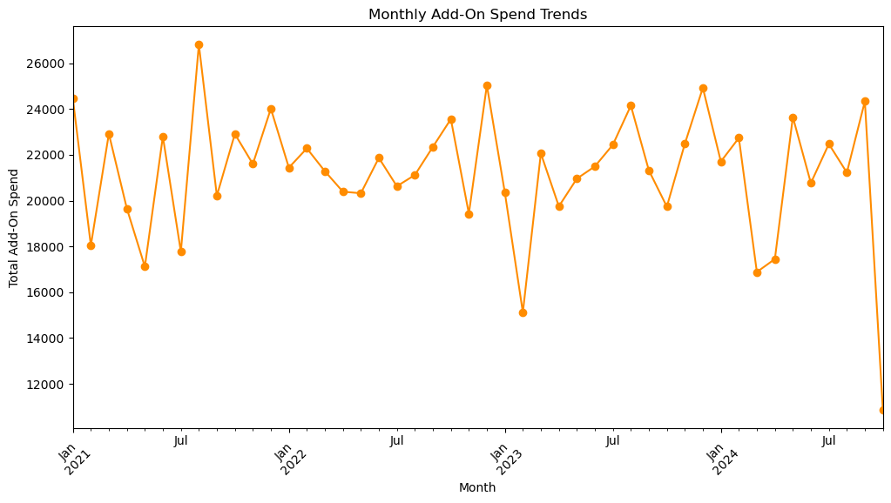
Monthly Add-On Spend Trends
This line chart illustrates the trends in monthly add-on spending over time. By tracking how customer spending fluctuates month-to-month, Delta can assess the impact of seasonal variations, promotional periods, or specific events on customer behavior. This visualization provides actionable insights for optimizing pricing strategies, adjusting marketing efforts, and forecasting future revenue from add-ons

